Slide 1

Oil Sands Projects
Lessons Learned
New User Orientation

Slide 2

New User Orientation – Lessons Learned
Objective
To provide new users an orientation of the new OSP Lessons Learned process and the supporting systems
Agenda
TLM Moment – Lessons Learned process overview
Lessons Learned definitions and expectations
Leveraging Lessons Learned
On-line capability - Sample screens

Slide 3
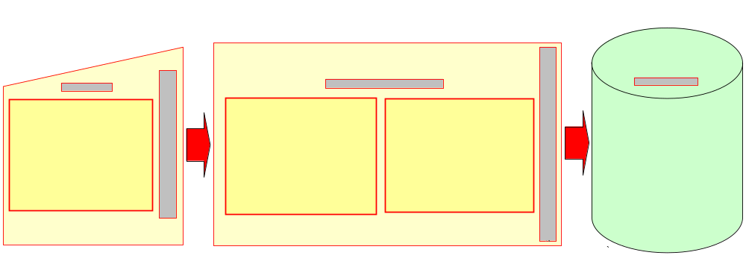
TLM Moment – Lessons Learned
Lessons Learned drive Continual Improvement and Cheaper, Better, Faster Oil Sands Projects
Continual Improvement is ongoing:
  Lessons Learned should be captured as experiences and learnings occur
  Stage Gate Process requires the capture of Lessons Learned

Slide 4
A Lesson Learned is…
Knowledge (based on experience) of a specific combination of factors (e.g. circumstances, requirements, capabilities, resources) that explains a cause and effect relationship
Which:
  is either positive (success) or negative (failure)
  is significant (beneficial, has an impact)
  is valid (confirmed to be accurate)
  is applicable (identifies a specific process, procedure, model, technology, etc.)
  is published and used on future projects - MOST IMPORTANT!!
    an “Action LL” where a change has been implemented (procedures, specs, process, standard, etc.)
        OR
    an “Awareness LL” to provide insights to future projects

Slide 5
A Lesson Learned System is……
A means (continuous cycle) of turning raw input (data) into useful knowledge (lessons learned) which:
  directly supports the organization’s ability to learn and continually improve (safety, cost, schedule, quality, etc.)
  is captured primarily in the formal documentation of the organization (e.g. standards, procedures, specifications, models, guidelines, practices, etc)
    captures major learnings in a readily accessible repository
  is supported by the individuals who contribute, participate and use the system and act upon lessons learned

Slide 6
Leveraging Lessons Learned
RESULTS
FOCUS & ACTION
REWARDS & RECOGNITION
LESSONS LEARNED ENABLERS
PEOPLE, PROCESSES AND SYSTEMS
THE OSP VISION
CHEAPER, BETTER, FASTER PROJECTS
POSITIVE CHANGES SUPPORTING THE CBF VISION
CONTINUAL IMPROVEMENT
Consistent, standardized process for input, searches and overall Lessons Learned information
Centralized, quality controlled, searchable data base with over 2000 historical entries already loaded
Intuitive, user friendly screens with on-screen support ( )
Complete workshop presentation kit including templates and guidelines for holding group sessions
help desk support at ospll@petro-canada.ca
Lessons Learned home page link: http://corpweb/ll/default.aspx

Slide 7
On-Line Demonstration Slides
Lessons Learned Home Page
Input Screen – first page
Input Screen – second page
Search Screen – all filters on
Print grid print out
Lesson Learned confirmation print out

Slide 8
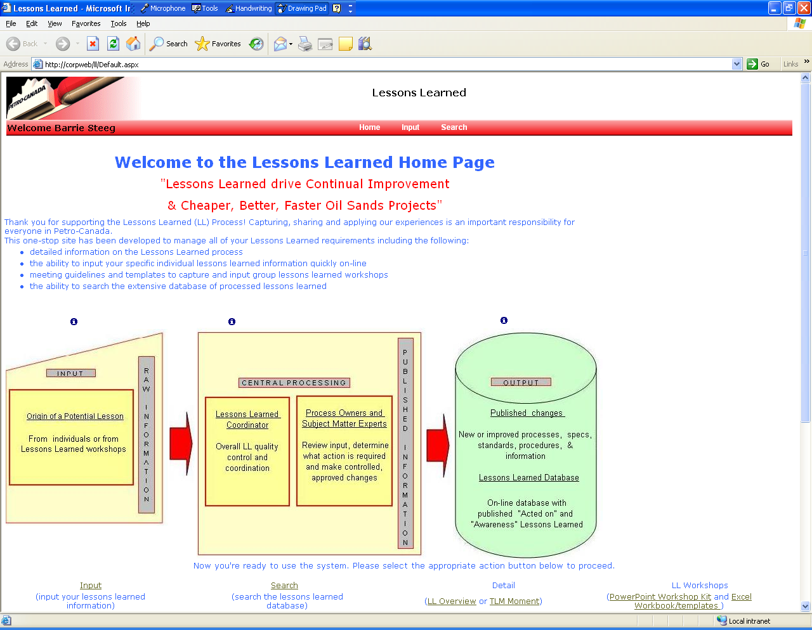
Lessons Learned Home Page

Slide 9
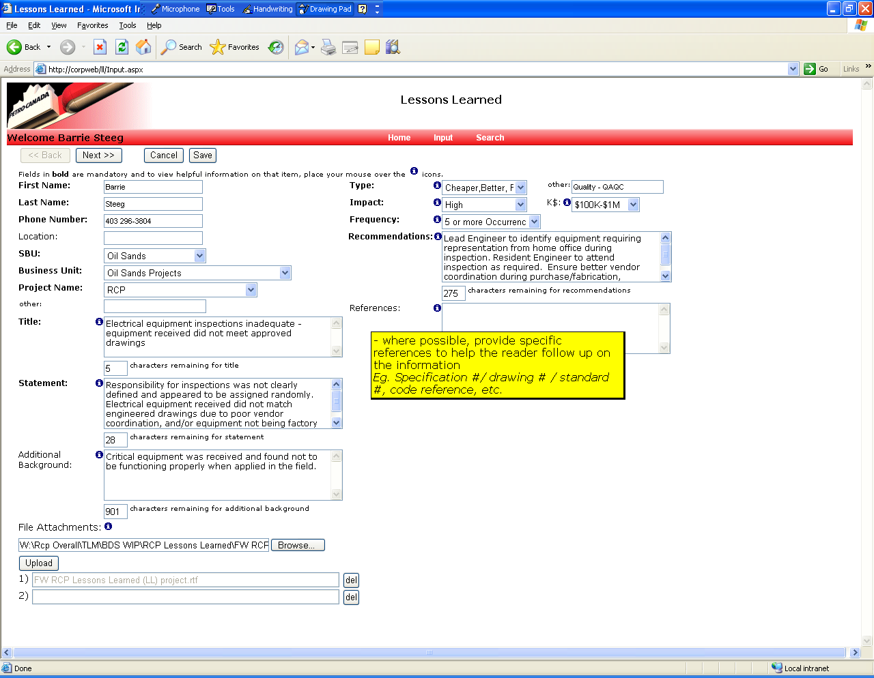
Lessons Learned Input Screen #1

Slide 10
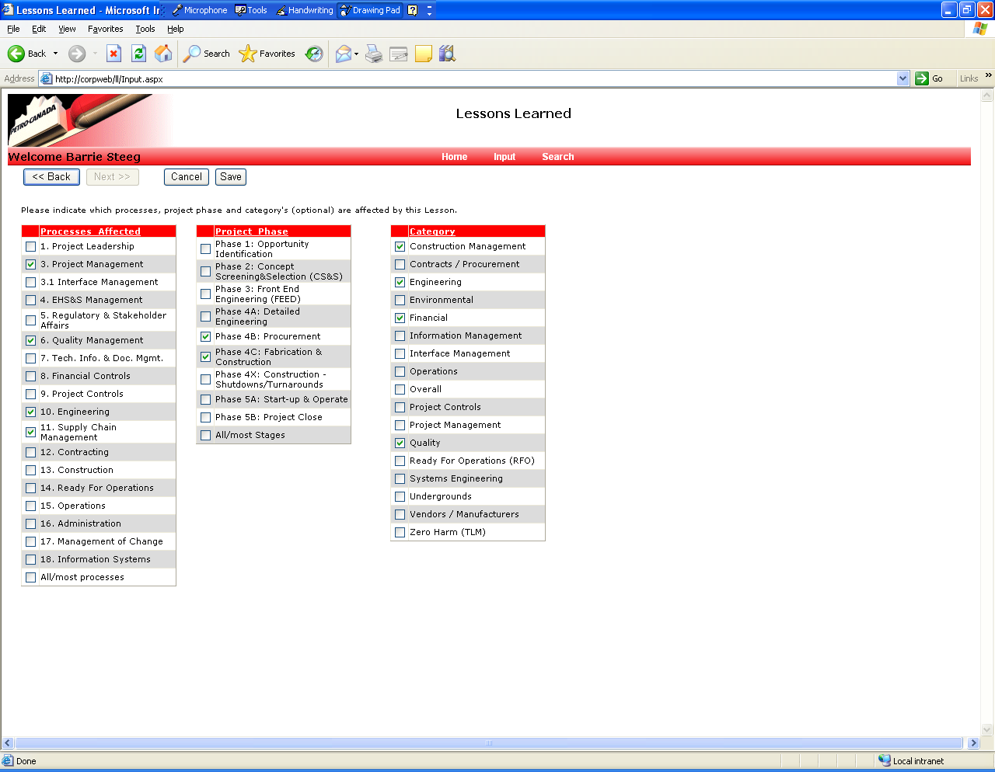
Lessons Learned Input Slide #2

Slide 11
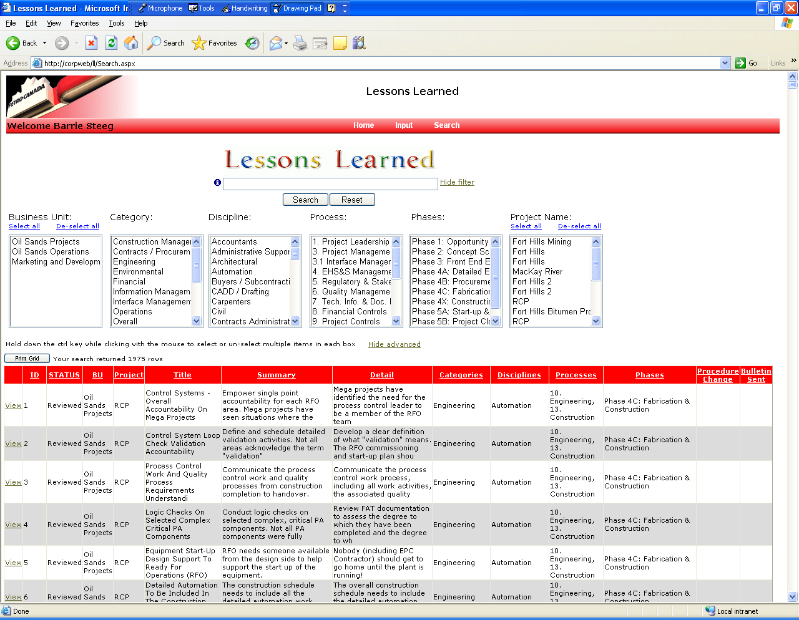
Lessons Learned Search Screen

Slide 12
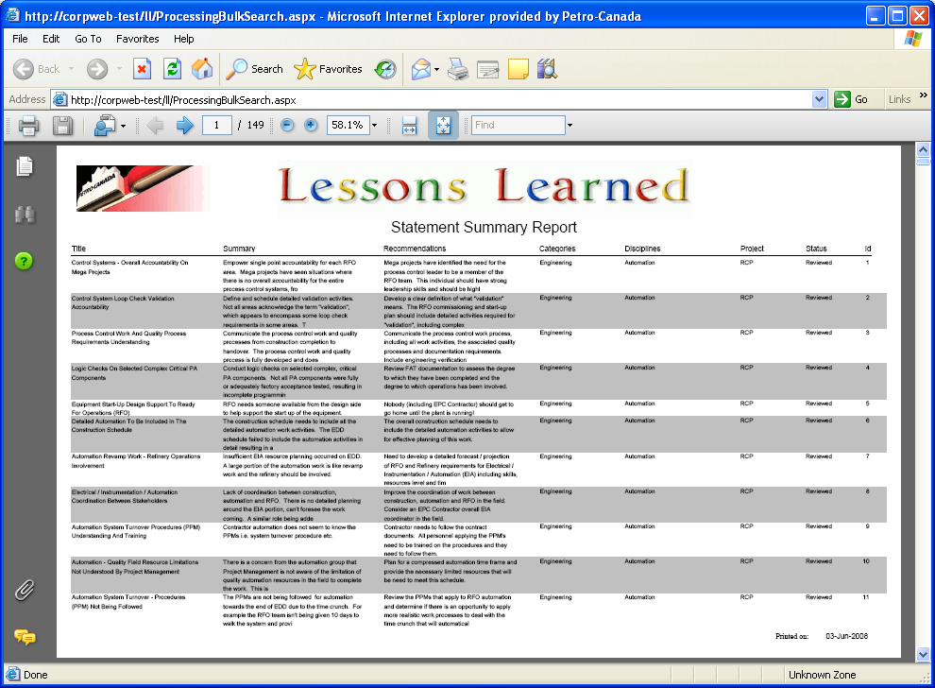
Search – LL Print Grid print out

Slide 13
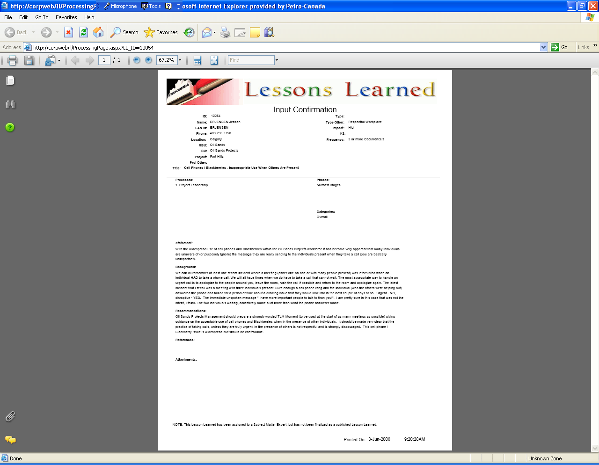
Search – LL View print out

